Slide 1
Learning Objective
I will be able to determine the global maxima and global minima of a function.
Success Criteria
At the end of the lesson, I will be able to:
Check the given domain by substitution for maxima and minima
Test the nature of any stationary points by using the second derivative
Apply the skills above to investigate authentic situations

Slide 2
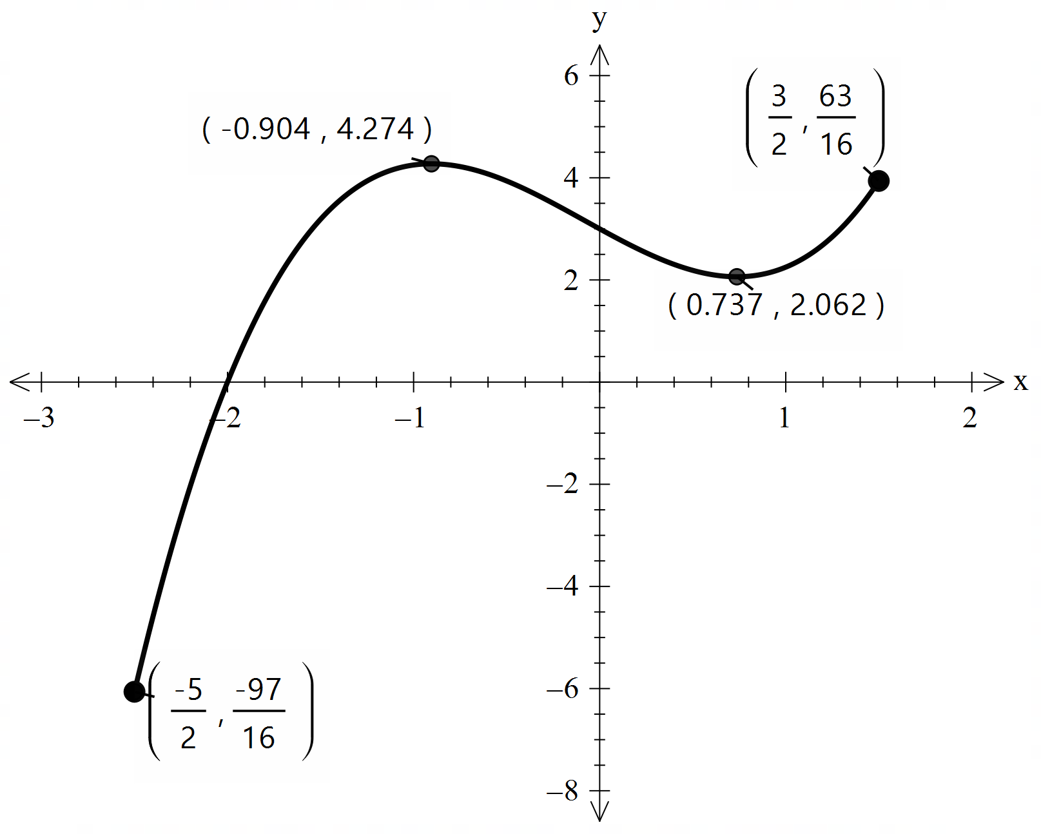
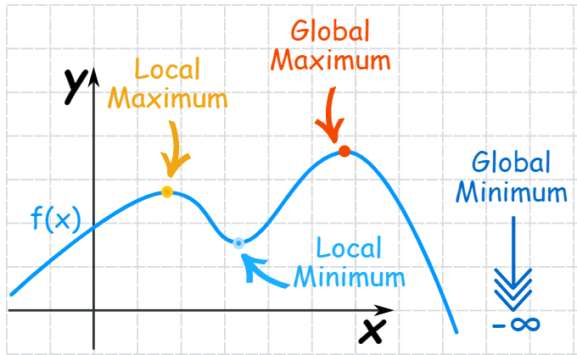

Local and Global max/min points
The maximum or minimum over the entire function is called an "Absolute" or "Global" maximum or minimum.
There is only one global maximum (and one global minimum) but there can be more than one local maximum or minimum.

Slide 3
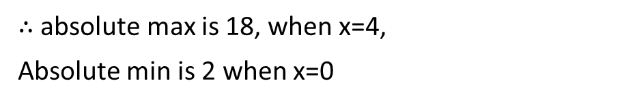
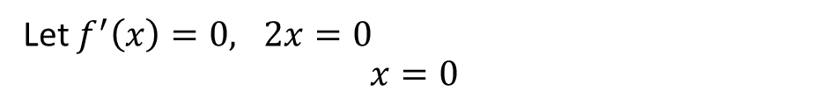

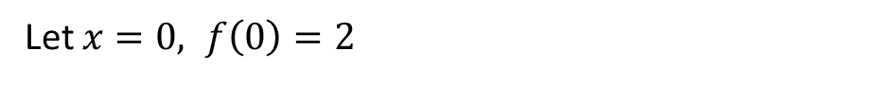
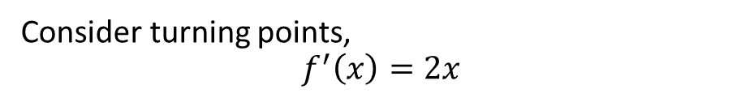
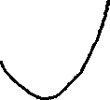
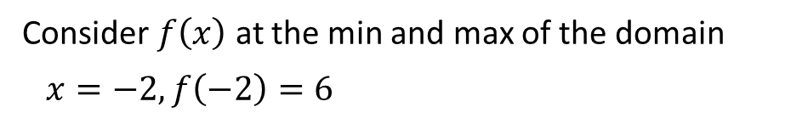
Guided Practice
Let $f\left(x\right)=x^{2}+2, \left\{x∈ℝ:−2≤x≤4\right\}$. Find the absolute maximum value and the absolute minimum value of the function.
Consider $f\left(x\right)$ at the min and max of the domain
$x=−2, f\left(−2\right)=6$
$$x=4 , f\left(4\right)=18$$
Consider turning points,
$$f^{′}\left(x\right)=2x$$
Let $f^{′}\left(x\right)=0, 2x=0$ $$x=0$$
Let $x=0, f\left(0\right)=2$
$∴$ absolute max is 18, when x=4,
Absolute min is 2 when x=0

Slide 4

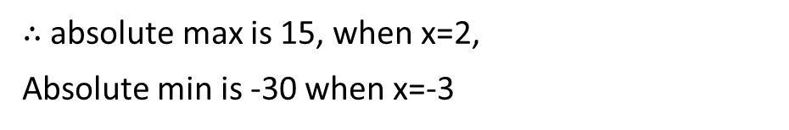
Guided Practice
Let $f\left(x\right)=x^{3}+2x+3, \{x∈ℝ:−3≤x≤2\}$. Find the absolute maximum and minimum value of the function for its domain.
$$f(x)=x^{3}+2x+3$$
Sub $x=−3, f(−3)={\left(−3\right)}^{3}+2\left(−3\right)+3$
$$=−27−6+3=−30$$
Sub $x=2, f(2)={\left(2\right)}^{3}+2\left(2\right)+3=15$
$f′(x)=3x^{2}+2$
Sub $f′(x)=0, 3x^{2}+2=0$
$x^{2}=−\frac{2}{3}$ Not possible as $x^{2}≥0∴$ no stationary points
$∴$ absolute max is 15, when x=2,
Absolute min is -30 when x=-3

Slide 5



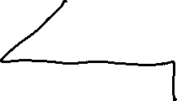
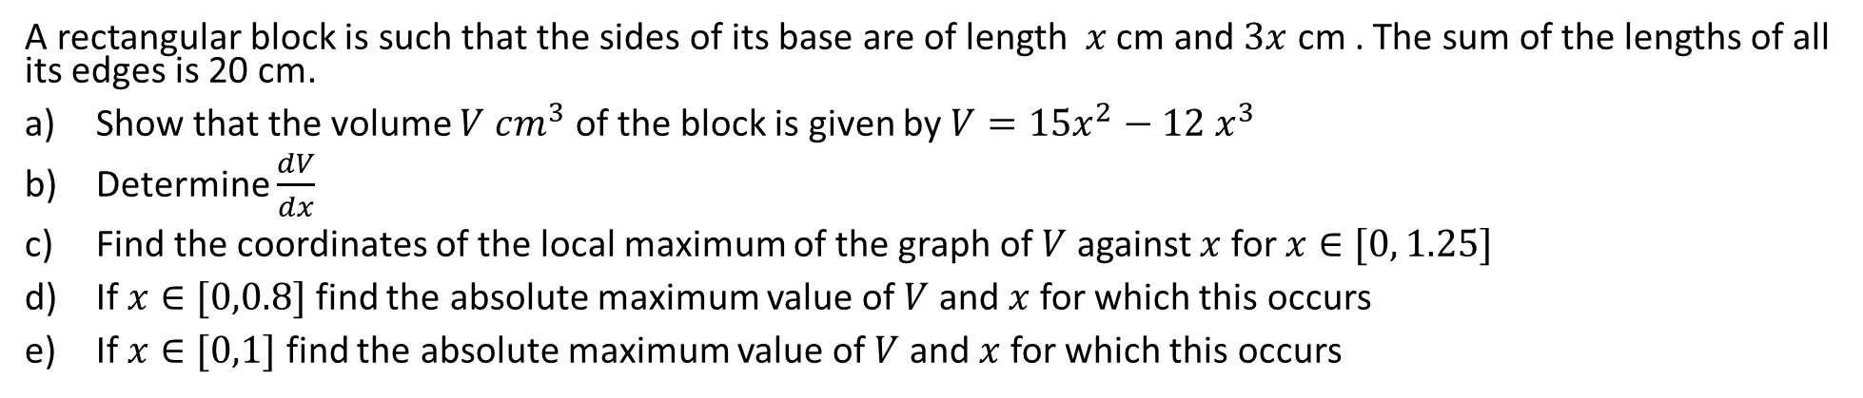

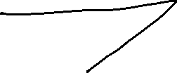



Guided Practice
A rectangular block is such that the sides of its base are of length $x$ cm and $3x$ cm . The sum of the lengths of all its edges is 20 cm.
Show that the volume $V cm^{3}$ of the block is given by $V=15x^{2}−12 x^{3}$
Determine $\frac{dV}{dx}$
Find the coordinates of the local maximum of the graph of $V$ against $x$ for $x∈[0, 1.25]$
If $x∈[0,0.8]$ find the absolute maximum value of $V$ and $x$ for which this occurs
If $x∈[0,1]$ find the absolute maximum value of $V$ and $x$ for which this occurs
a) $2\left(2×x+2×3x\right)+4h=20$
c)Subst $\frac{dV}{dx}=0,30x−36x^{2}=0$
$$4h=20−16x$$
$$h=5−4x$$
$$6x(5−6x)=0$$
$$x=0, x=\frac{5}{6}$$
$$V=x×3x×h$$
$$V=3x^{2}\left(5−4x\right)$$
$$\frac{d^{2}V}{dx^{2}}=30−72x$$
$$V=15x^{2}−12x^{3}$$
b) $\frac{dV}{dx}=15\left(2\right)x−12(3)x^{2}$
Sub $x=0, \frac{d^{2}V}{dx^{2}}=30>0, ∴$ at $x=0$ it gives a minimum turning point
$$=30x−36x^{2}$$
Sub $x=\frac{5}{6}, \frac{d^{2}V}{dx^{2}}=30−60=−30<0, ∴$ at $x=\frac{5}{6}$ it gives a maximum turning point
Sub $x=\frac{5}{6}$ into V, $V=\frac{125}{36}cm^{3}$ the local maximum is $\left(\frac{5}{6},\frac{125}{36}\right)$

Slide 6

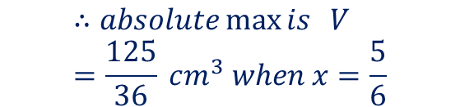


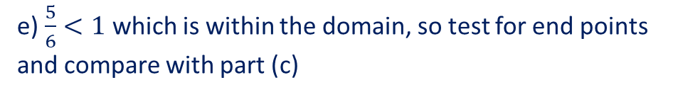

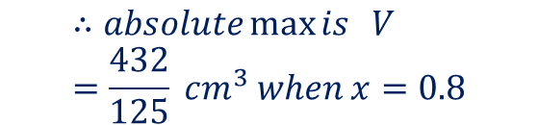
Guided Practice
A rectangular block is such that the sides of its base are of length $x$ cm and $3x$ cm . The sum of the lengths of all its edges is 20 cm.
Show that the volume $V cm^{3}$ of the block is given by $V=15x^{2}−12 x^{3}$
Determine $\frac{dV}{dx}$
Find the coordinates of the local maximum of the graph of $V$ against $x$ for $x∈[0, 1.25]$
If $x∈[0,0.8]$ find the absolute maximum value of $V$ and $x$ for which this occurs
If $x∈[0,1]$ find the absolute maximum value of $V$ and $x$ for which this occurs
d) $\frac{5}{6}>0.8 which is out of the domain$
e) $\frac{5}{6}<1$ which is within the domain, so test for end points and compare with part (c)
$∴$ test the end points
Sub $x=0, V=0$
Sub $x=1, V=3<\frac{125}{36}$
Sub $x=0.8, V=\frac{432}{125} cm^{3}$
$$∴absolute\max{is } V=\frac{125}{36} cm^{3} when x=\frac{5}{6}$$
$$∴absolute\max{is } V=\frac{432}{125} cm^{3} when x=0.8$$

Slide 7


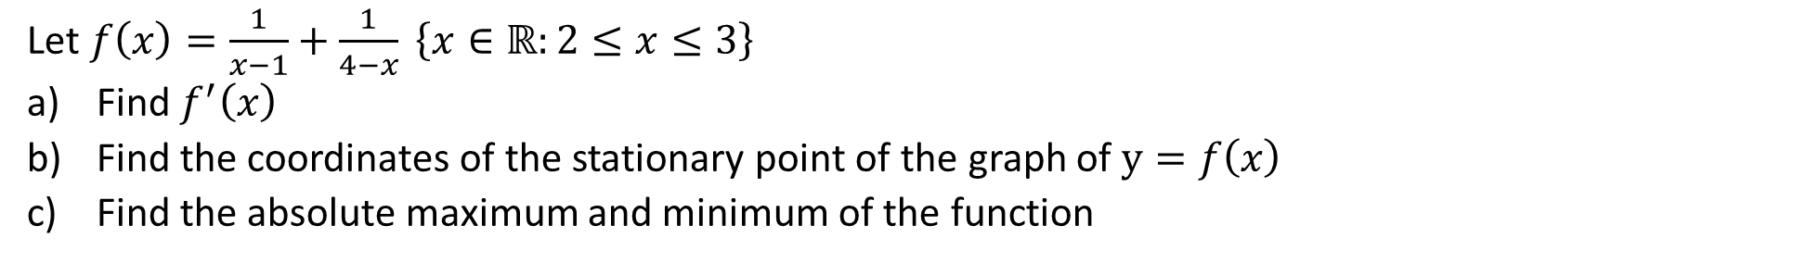



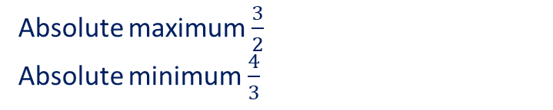


Guided Practice
Let $f\left(x\right)=\frac{1}{x−1}+\frac{1}{4−x} \left\{x∈ℝ:2≤x≤3\right\}$
Find $f^{′}\left(x\right)$
Find the coordinates of the stationary point of the graph of $y=f\left(x\right)$
Find the absolute maximum and minimum of the function
$$f\left(x\right)={\left(x−1\right)}^{−1}+{\left(4−x\right)}^{−1}$$
c) Subst $x=2, f\left(2\right)=\frac{3}{2}$
$$f′\left(x\right)=(−1){\left(x−1\right)}^{−2}+(−1)(−1){\left(4−x\right)}^{−2}$$
$$f^{′}(x)=−\frac{1}{{\left(x−1\right)}^{2}}+\frac{1}{{\left(4−x\right)}^{2}}$$
Subst $x=3, f\left(3\right)=\frac{3}{2}$
Absolute maximum $\frac{3}{2}$
Absolute minimum $\frac{4}{3}$
b) Subst $f^{′}\left(x\right)=0, 0=−\frac{1}{{\left(x−1\right)}^{2}}+\frac{1}{{\left(4−x\right)}^{2}}$
$$0=−{\left(4−x\right)}^{2}+{\left(x−1\right)}^{2}$$
$$x^{2}−2x+1−\left(16−8x+x^{2}\right)=0$$
$$6x−15=0$$
$$x=\frac{5}{2}$$
$$f\left(\frac{5}{2}\right)=\frac{4}{3}$$
$∴$ the coordinates are $\left(\frac{5}{2},\frac{4}{3}\right)$

Slide 8
Independent Practice
Complete Cambridge Ex 5G

